Slide 1


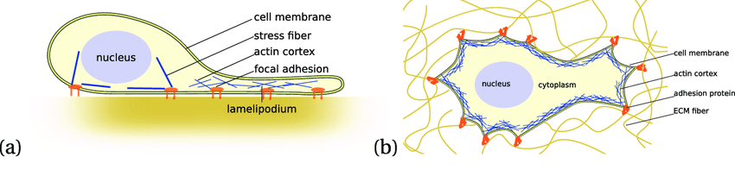
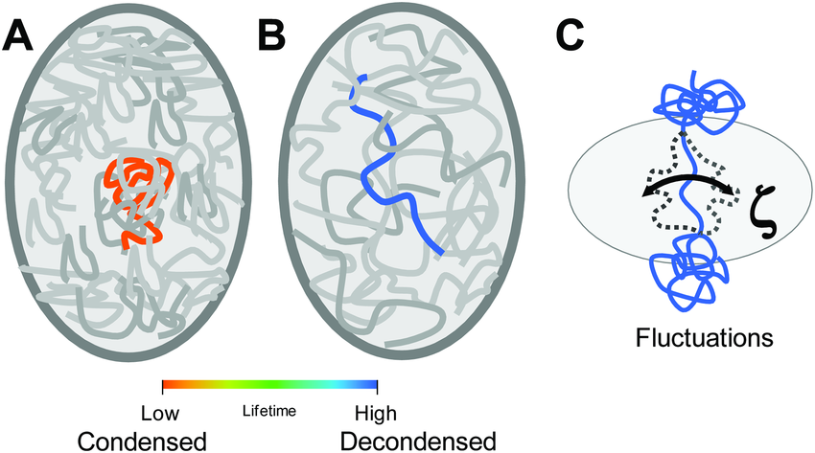
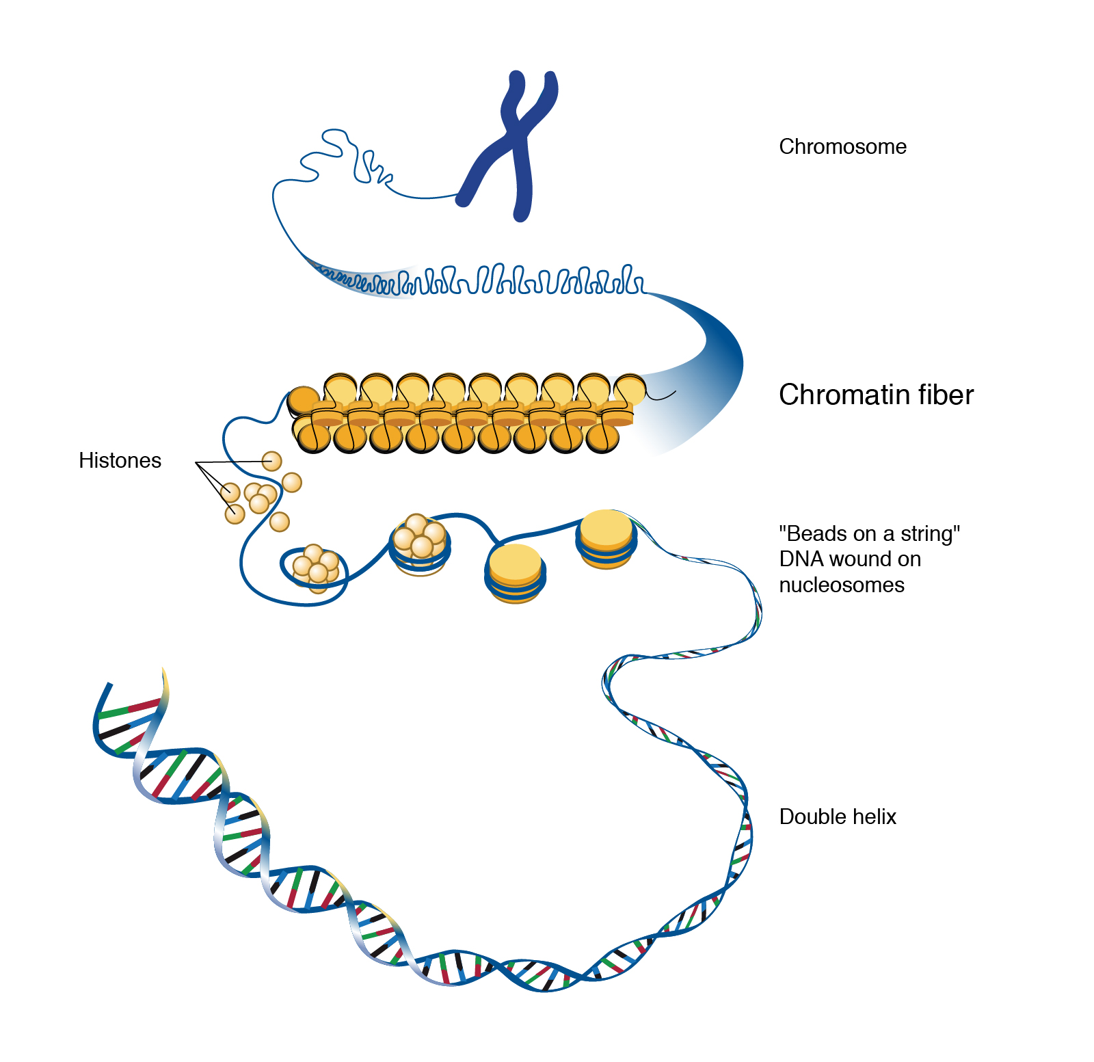
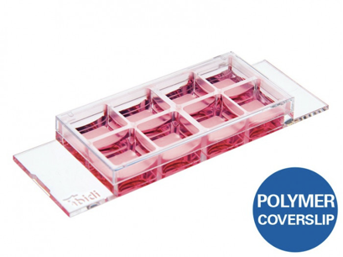
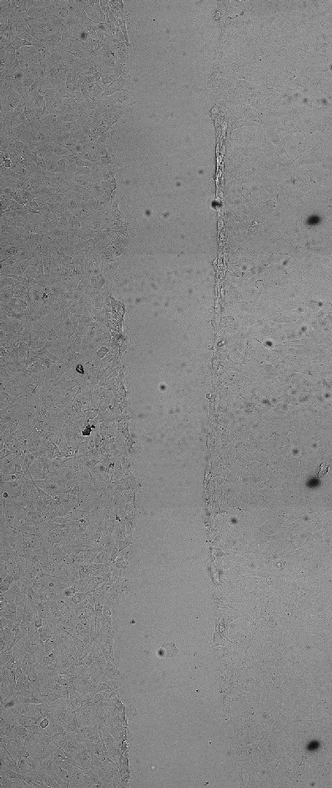
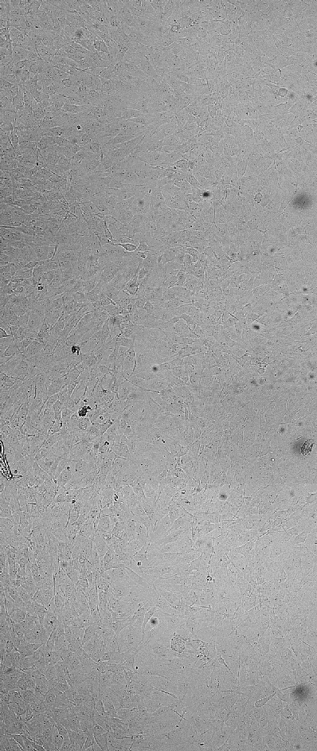
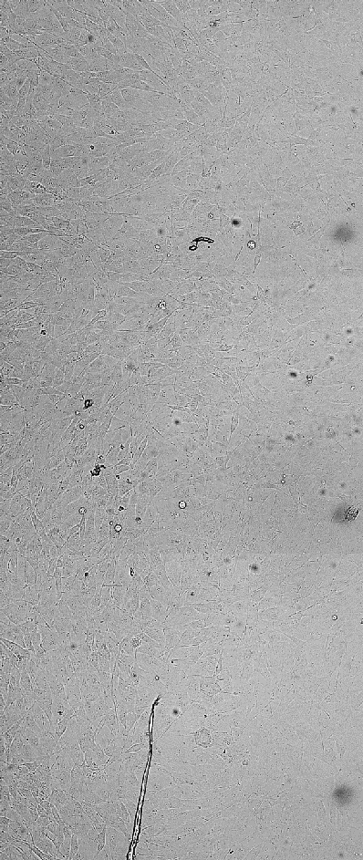
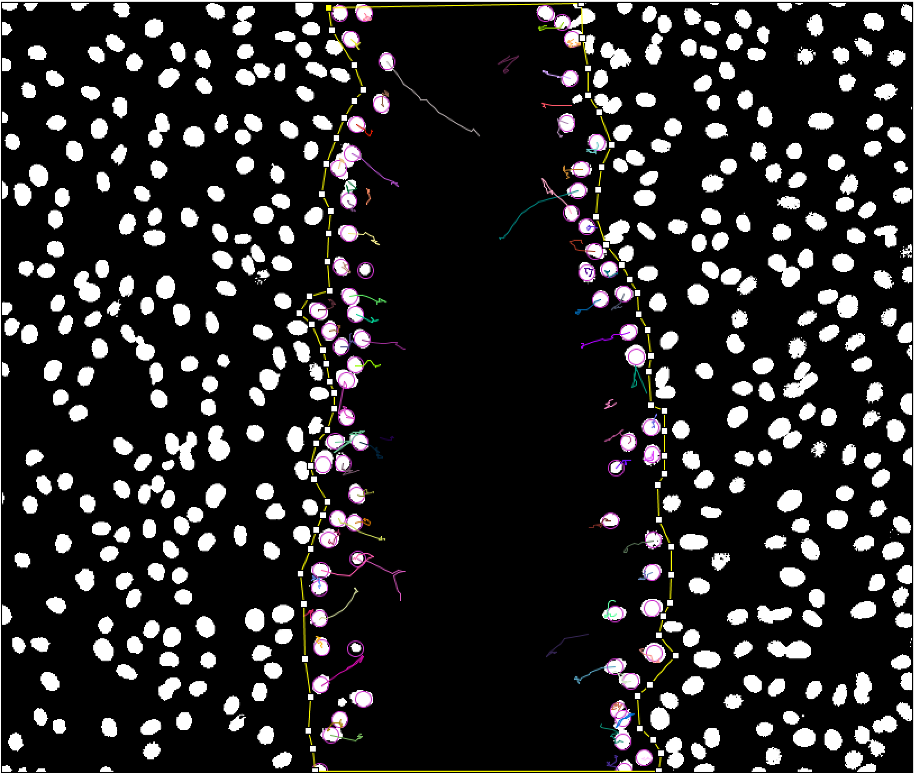
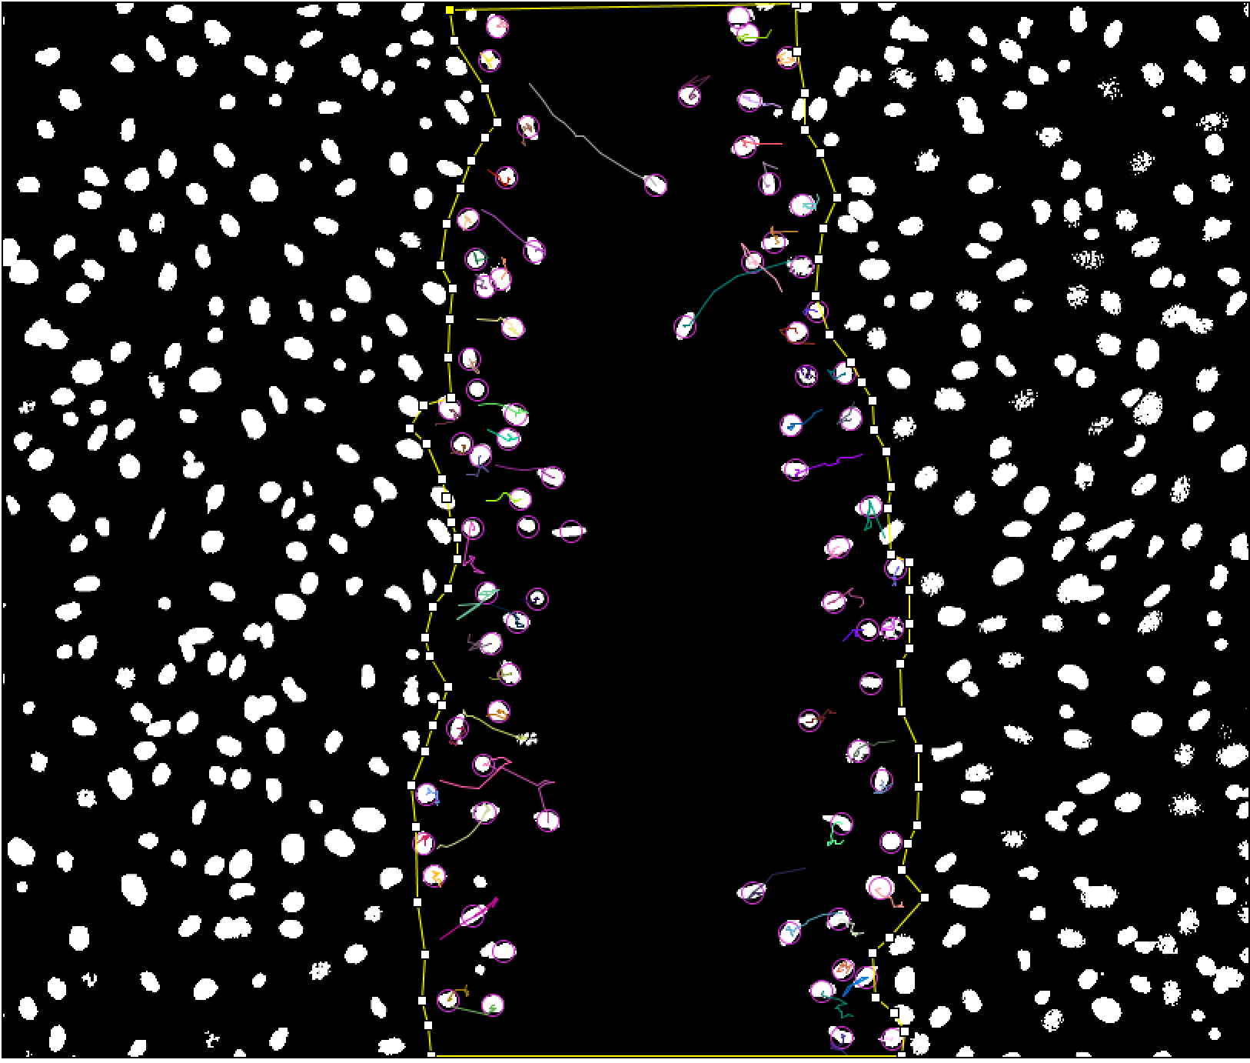
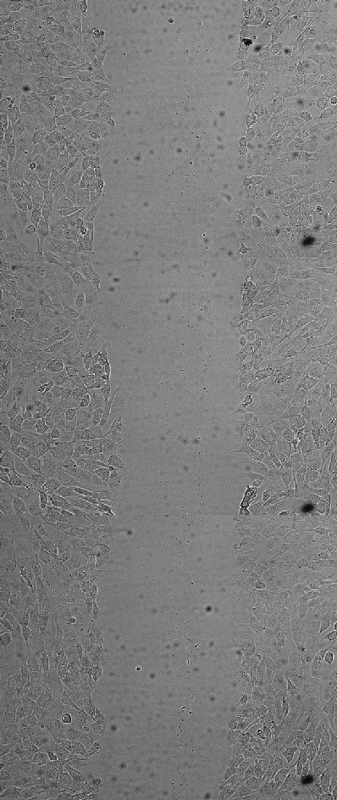
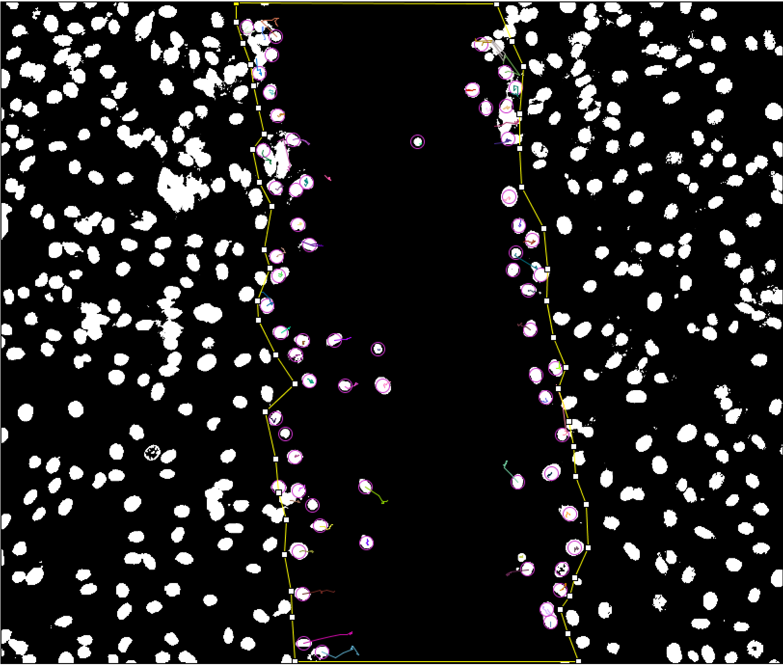
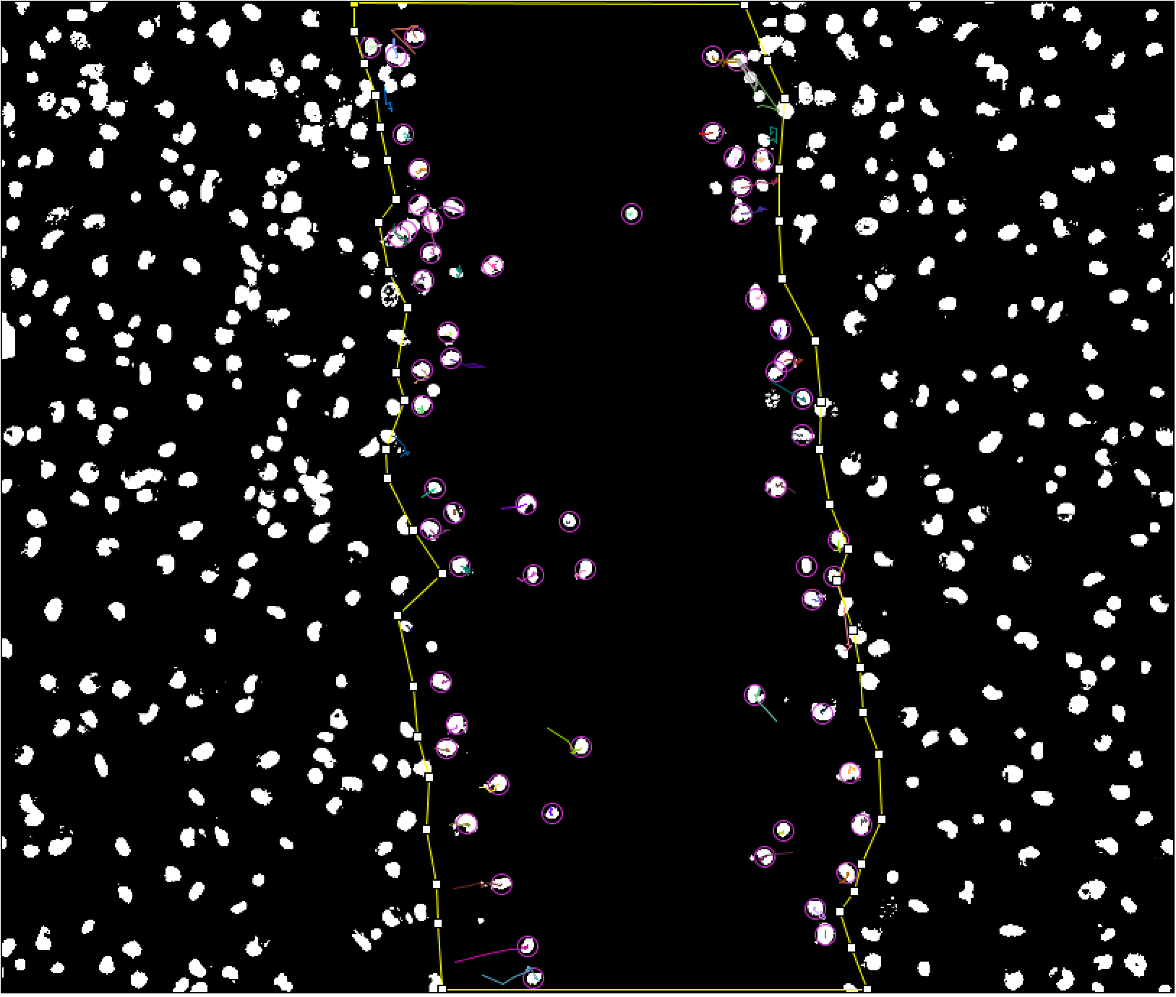
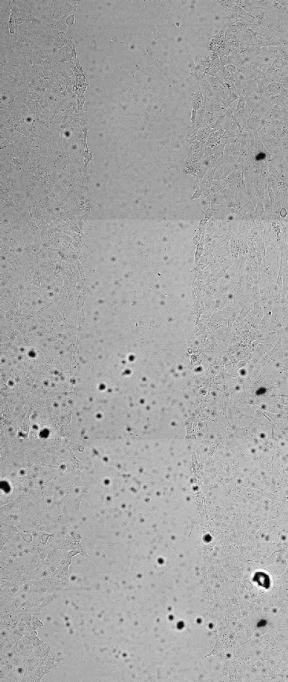
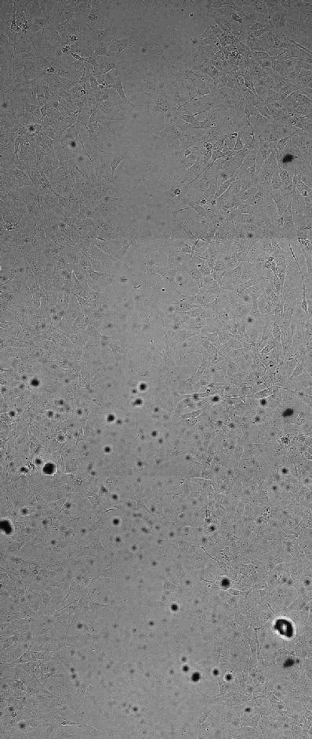
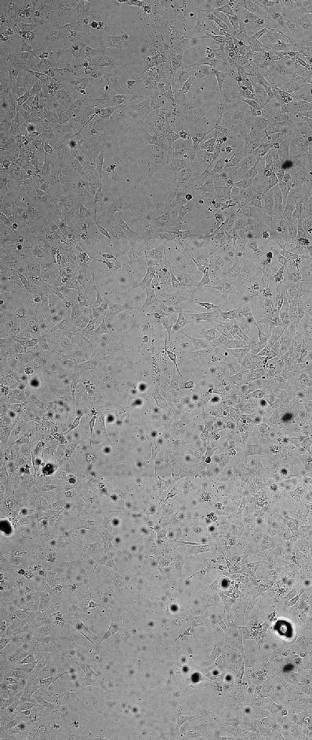
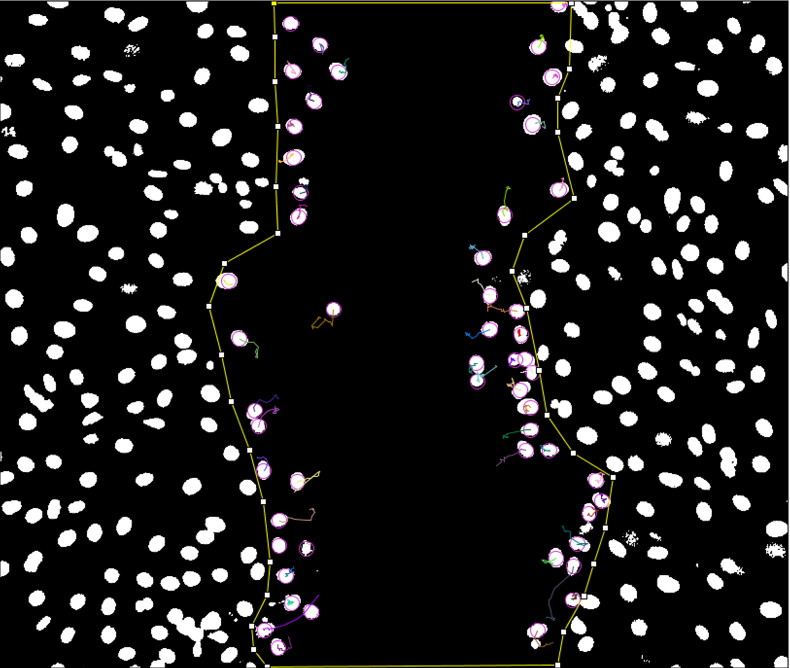
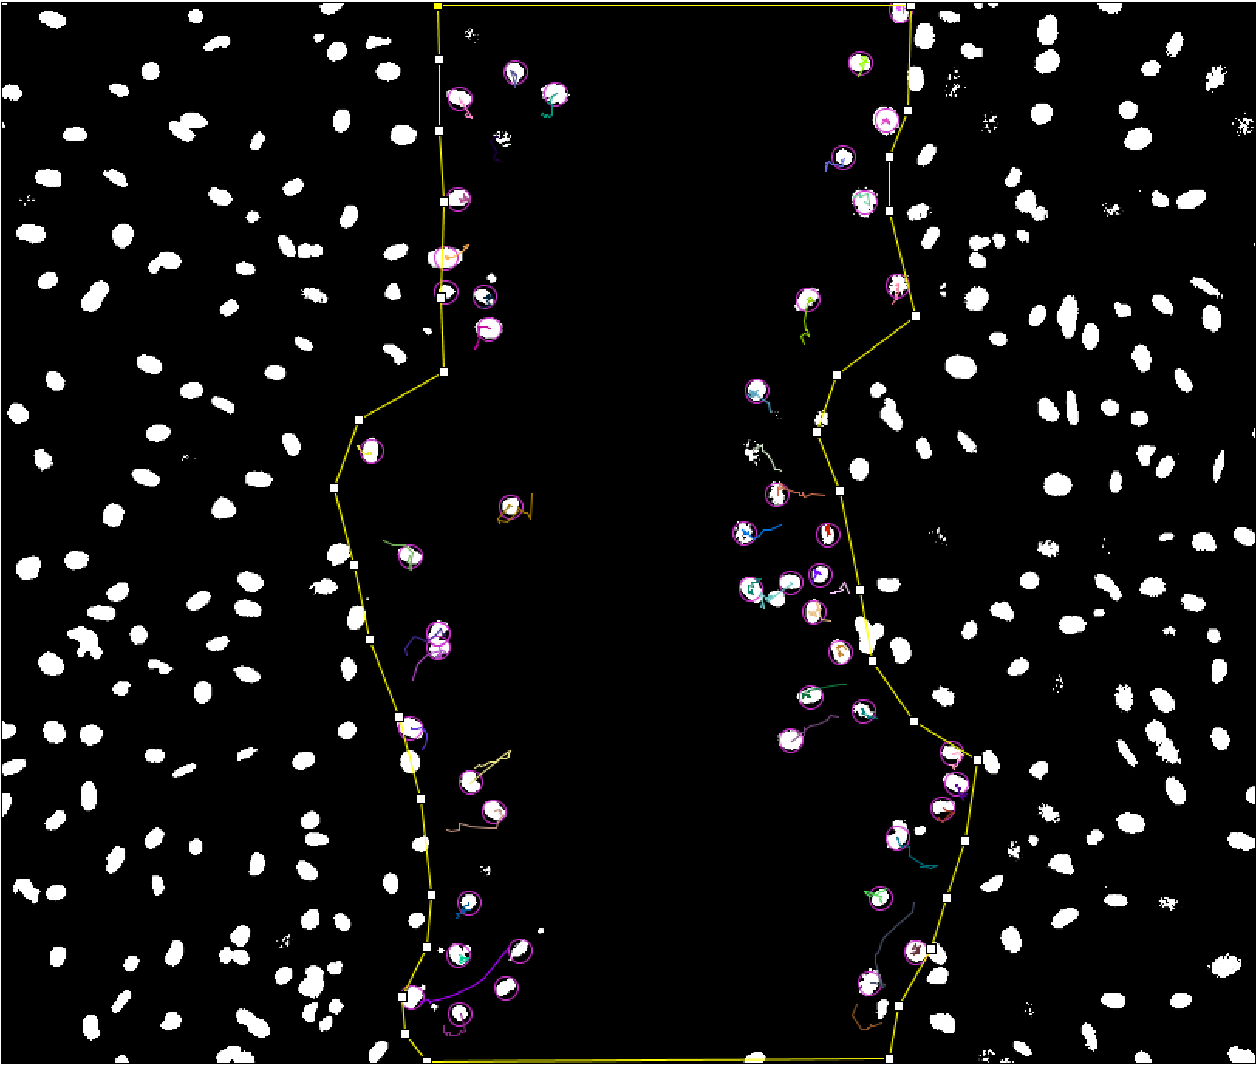
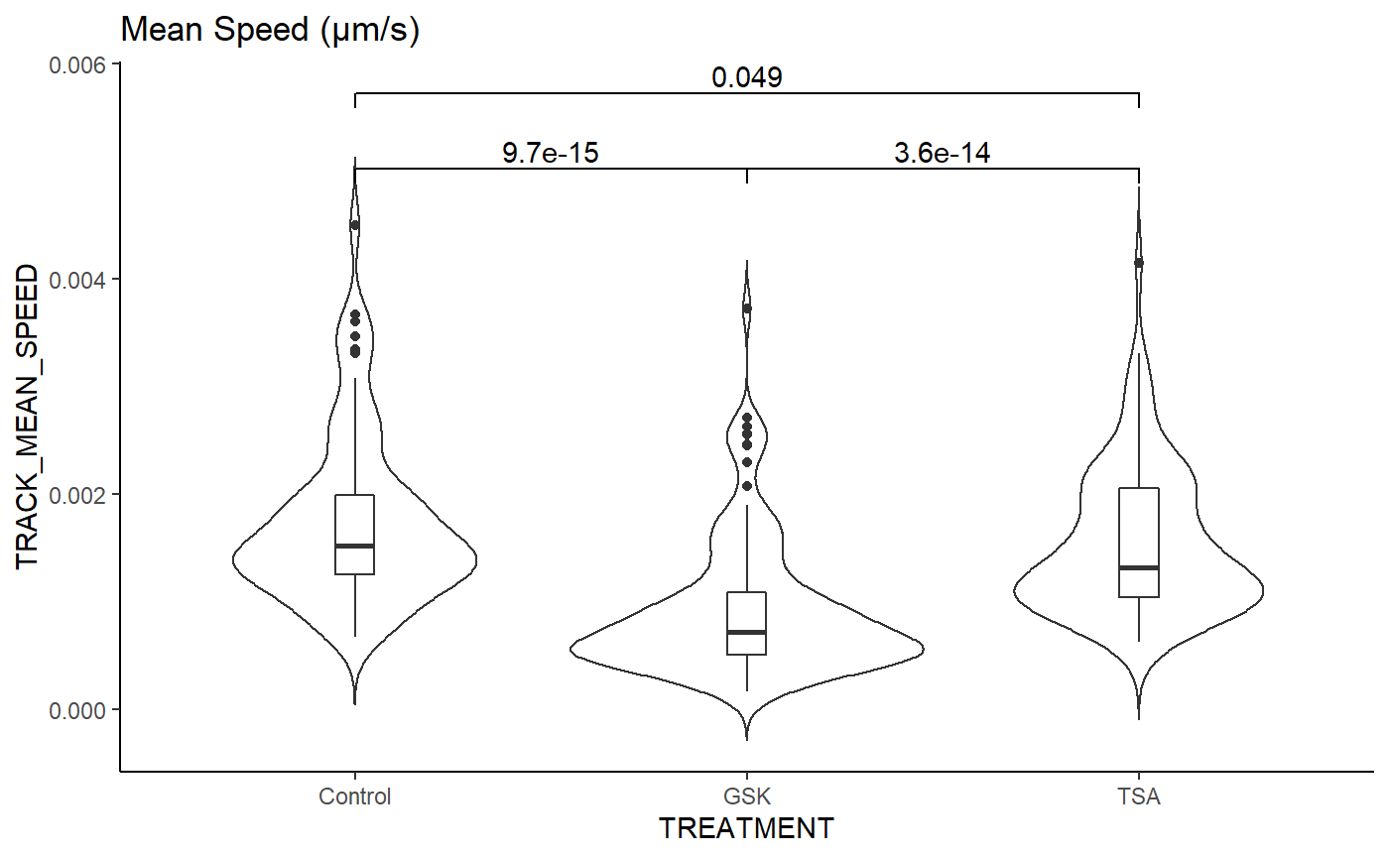
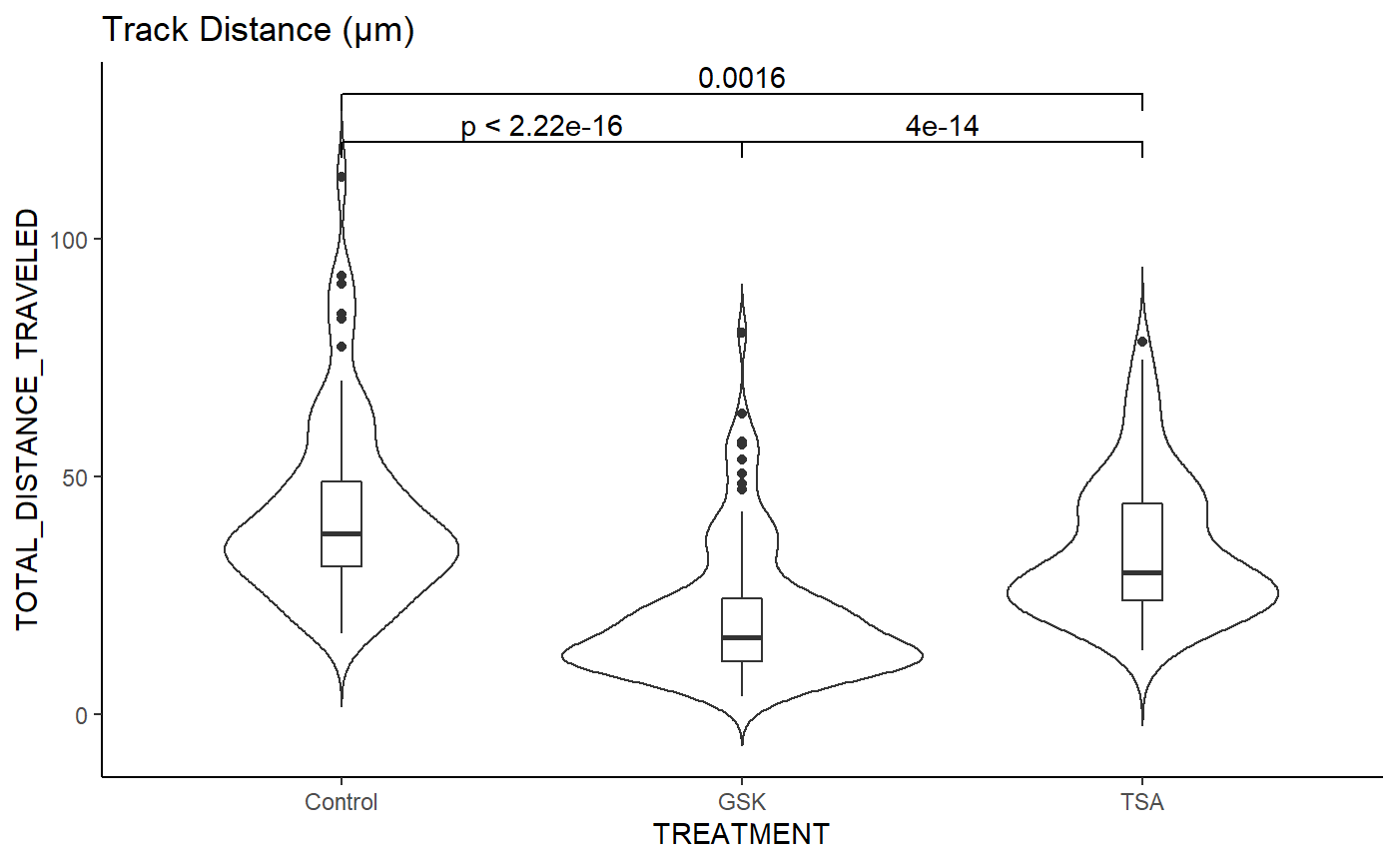
The Role of the Nucleus in Collective Cell Migration
Brady Hine^{1,2,3}, Samantha Kaonis^{1,3}, Soham Ghosh^{1,2,3}
¹School of Biomedical Engineering, ² Mechanical Engineering Department, ³Translational Medicine Institute at Colorado State University
A
Introduction
C
Materials and Methods
B
Scratch Wound Assay:
A layer of murine fibroblast cells (3T3) is cultured in an 8-well plate.
A scratch is applied, and time lapse imaging of the healing process provides migration data.
Automated cell tracking is done on stained nuclei to collect quantitative data using TrackMate⁶ for Fiji⁷.
All imaging done using Zeiss LSM 980 microscope.
Collective cell migration is crucial for many biological processes including development, wound healing, and tissue engineering applications.
The cell nucleus is emerging as a key player in this process as it’s the largest and stiffest organelle^{4,5}.
We hypothesize that chromatin remodeling, inhibited by GSK126, and nuclear stiffness, inhibited by Trichostatin A (TSA), are key mediators of cell migration.
Figure 1. (A) Visualization of single cell crawling in 2D¹. (B) Depiction of condensed chromatin (left) and decondensed chromatin (right)² illustrating GSK126 and TSA treatments respectfully. (C) Visualization of chromosome structure showing a chromosome, chromatin fiber, histones, nucleosomes, and DNA from top to bottom³.
To investigate how nuclear mechanics and chromatin remodeling affect collective cell migration using a model scratch wound assay.
Goal
Figure 2. A cartoon illustrating the initiation of the scratch wound assay (top), how this scratch looks under the microscope (bottom-left), and what migration into the wound looks like with cells stained for the nucleus and actin (bottom-right).
Results and Discussion
Control Group
Control Group
Control Group
20μM GSK126
20μM GSK126
20μM GSK126
100 ng/mL TSA
100 ng/mL TSA
Brightfield 2 hours
DAPI 2 hours
DAPI 5.5 hours
DAPI 8.5 hours
100 ng/mL TSA
0.006
Mean Speed (μm/s)
0.049
Track Distance (μm)
0 hours
11 hours
24 hours
25.5 hours
9.7e-15
3.6e-14
100
p < 2.22e-16
0.0016
4e-14
2 hours
2 hours
8.5 hours
0.004
Figure 5. TrackMate path visualization for cells migrating in figure 4. Cell nuclei are shown as white dots with spot detection shown as purple rings and migration tracks shown as colored lines for cells on the wound edge encompassed by a yellow polygon.
0.002
50
0.000
Control
GSK
TSA
0
Control
GSK
TSA
Conclusion
Figure 4. (Top) Scratch wound assay images live stained for the nucleus with DAPI. Detailed chromatin architecture is highlighted in the 5.5-hour images. Scale bar is 100 μm (Bottom) Violin plots for the mean speed and track distance of migrating cells at the wound edge. TSA shows a small decrease in speed and distance while GSK126 drastically decreased speed and distance. (n > 73) cells tracked for each group.
→ Trichostatin A decreases migration speed and wound closure efficiency
GSK126 decreases wound closure efficiency and drastically reduces migration speed
Figure 3. (Top) Scratch wound assay images for control, GSK126, and TSA groups from 0-25.5 hours with final fixed images stained for nuclei in purple and actin in green. Scale bar is 100 μm. (Bottom) Wound closure percentage graphs of groups at 11 and 24 hours showing a significant decrease for the TSA and GSK126 treatments. Error bars show standard deviation about the mean with (n = 3) samples.
Future Work
References and Acknowledgments
Next Steps:
Investigate angular components of migration to determine if chromatin remodeling affects the ability to follow collective migration gradients.
Development of a predictive biophysical model to determine migration parameters from the nuclear mechanics/chromatin remodeling parameters.
Adapting the methods created in this study to other cell types for fundamental biophysical research and applied translational research.
[1] Fruleux et al, 2016, Journal of Physics Condensed Matter 28(36):363002.
[2] Spagnol et al, 2016, Plos ONE 11(1):e0146244.
[3] Chromatin, National Human Genome Research Institute.
[4] Jain et al, 2020, Nat. Phys. 26(7), 802-809.
[5] Graham et al, 2018, J. Cell Biol. 217(3), 895-914.
[6] Tinevez et al, 2017, Methods 115, 80–90.
[7] Schindelin et al, 2012, Nature Methods 9(7), 676–682.

